Slide 1
Programming JAVA {
Hiveed.java
JAVA PROGRAMMING ;
/* Here is where your journey for your dream begins */
}
JAVA Programming

Slide 2
Table Of ‘Contents’
01
Hiveed.java
{
Conditional Statement ;
}
JAVA Programming

Slide 3
Hiveed.java
What is Conditional Statement :
Programmmer can decide which instruction need to be executed and which instruction need to be ignore. Using decision making statement .
The decision making Statement always execute the instruction if the condition is true.
We have following decision making statement.
Simple if
if else
else if ladder
switch
JAVA Programming

Slide 4
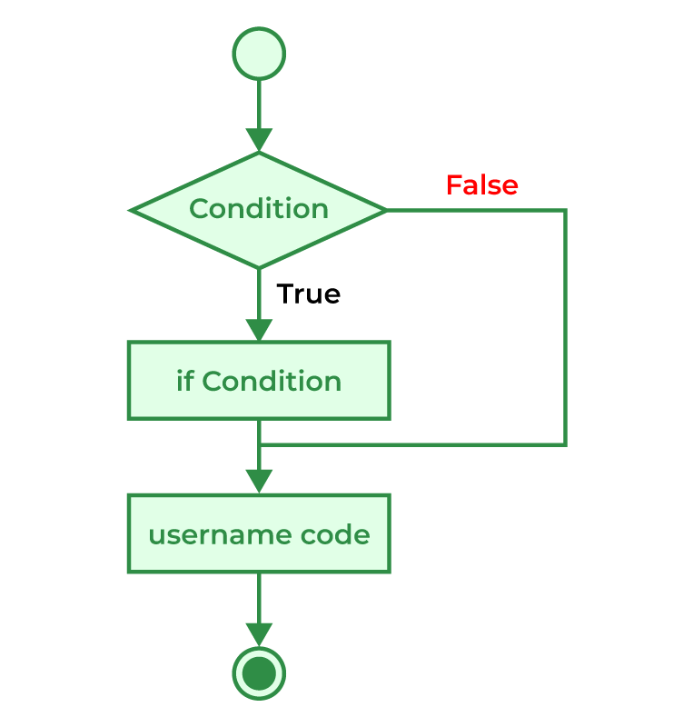
Hiveed.java
Simple if :
A simple "if" statement is used to execute a block of code if a specified condition is true.
Syntax :
if (Condition){
// condition is true statement is executed.
}
JAVA Programming

Slide 5
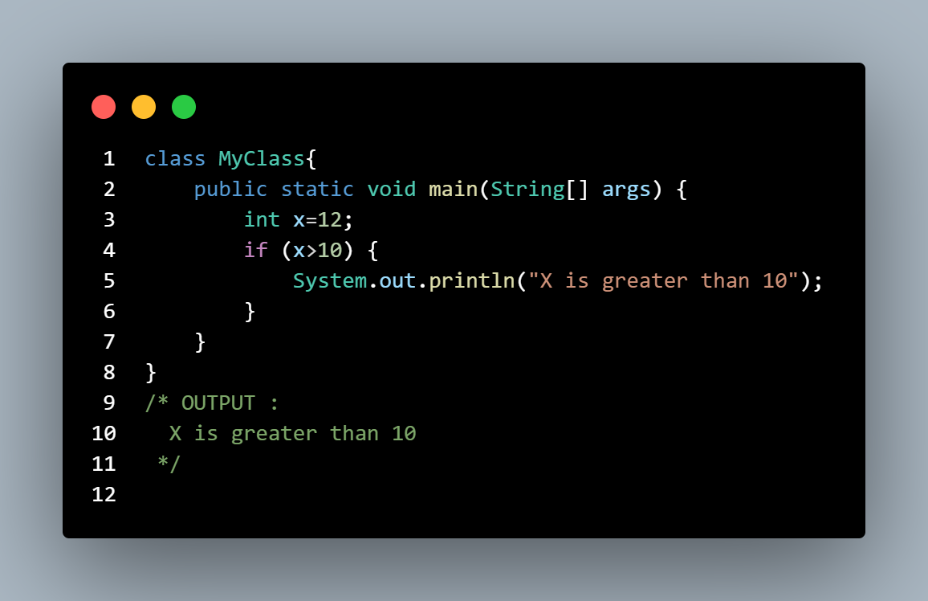
Hiveed.java
Simple if Example :
JAVA Programming

Slide 6
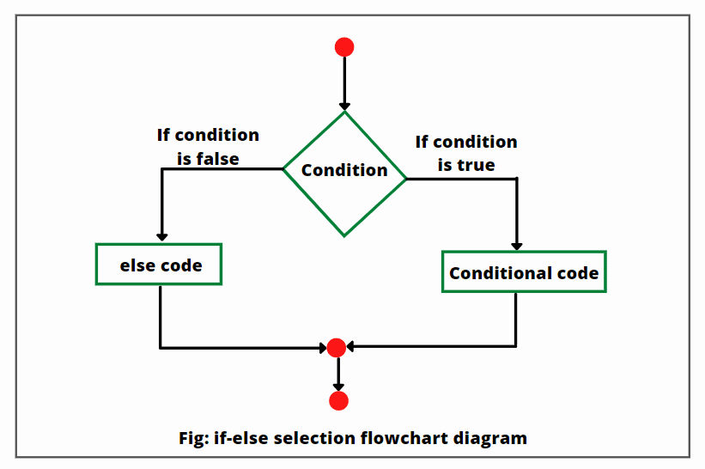
Hiveed.java
if else:
The "if-else" statement allows you to execute one block of code if a specified condition is true and another block of code if the condition is false.
Syntax :
if (Condition){
// condition is true statement is executed.
}
else {
// condition is False statement is executed.
}
JAVA Programming

Slide 7
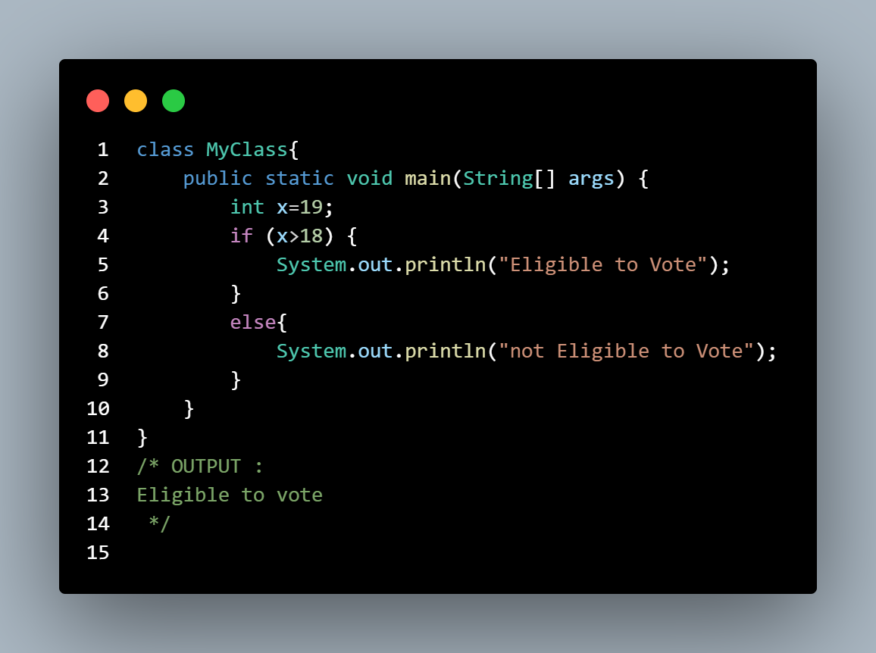
Hiveed.java
if else Example :
JAVA Programming

Slide 8
Hiveed.java
else if ladder:
It allows you to check multiple conditions sequentially, executing different blocks of code depending on which condition is true.
It's useful when you have more than two possible outcomes. Here's the basic syntax
Syntax :
if (Condition){
// condition is true statement is executed.
}
else if(condition){
// condition is True statement is executed.
}
else{
// condition is False statement is executed.
}
JAVA Programming

Slide 9
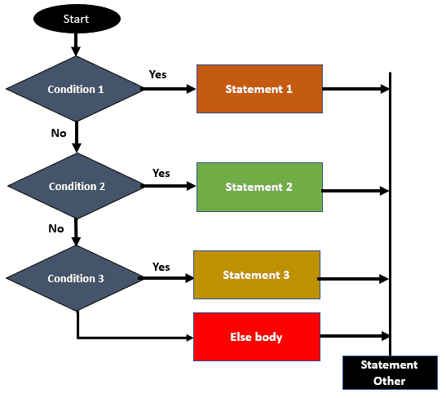
Hiveed.java
JAVA Programming

Slide 10
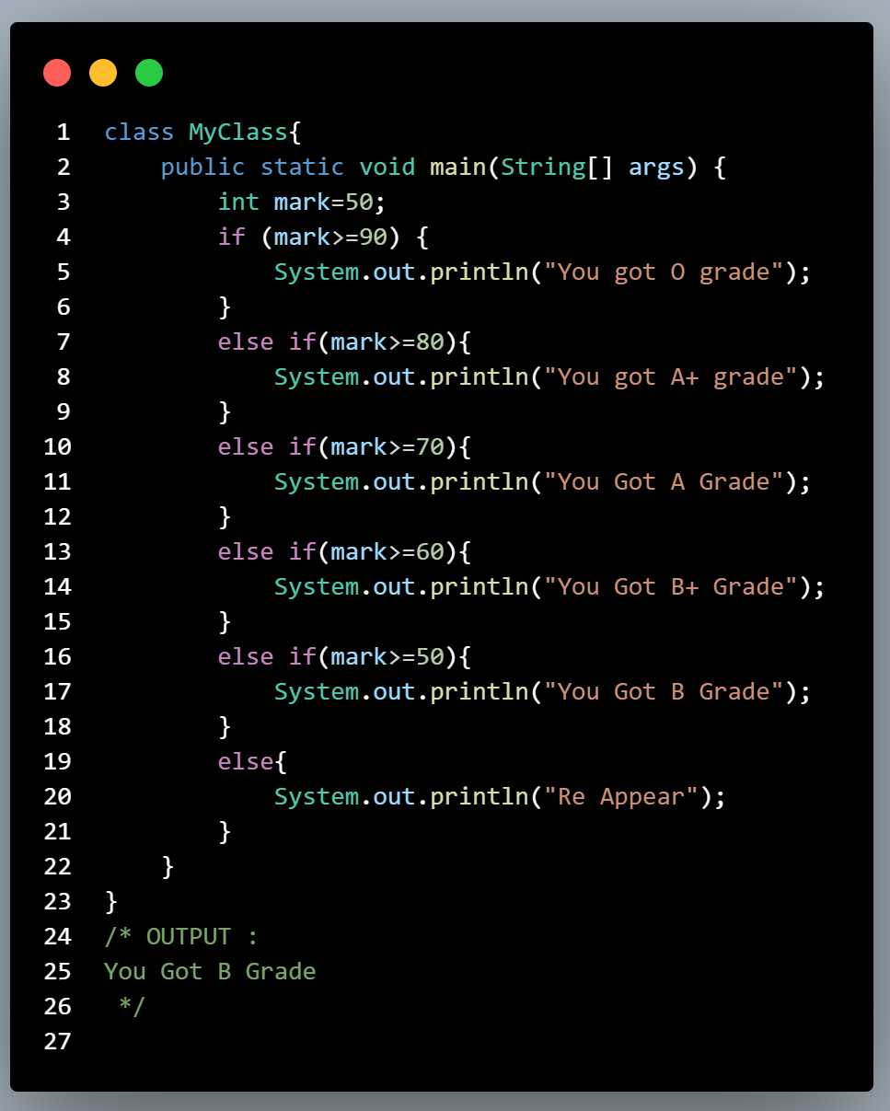
Hiveed.java
else if ladder Example :
JAVA Programming

Slide 11
Hiveed.java
Switch case :
Switch case statement evaluates a given expression and based on the evaluated value(matching a certain condition).
It executes the statements associated with it.
Inside swich programmer can pass [ Value / Variable / Expression ].
It very mush better performance than else if ladder.
Inside the Switch [ long , float , double , Boolean These type of Variable programmer cannot pass ].
JAVA Programming

Slide 12
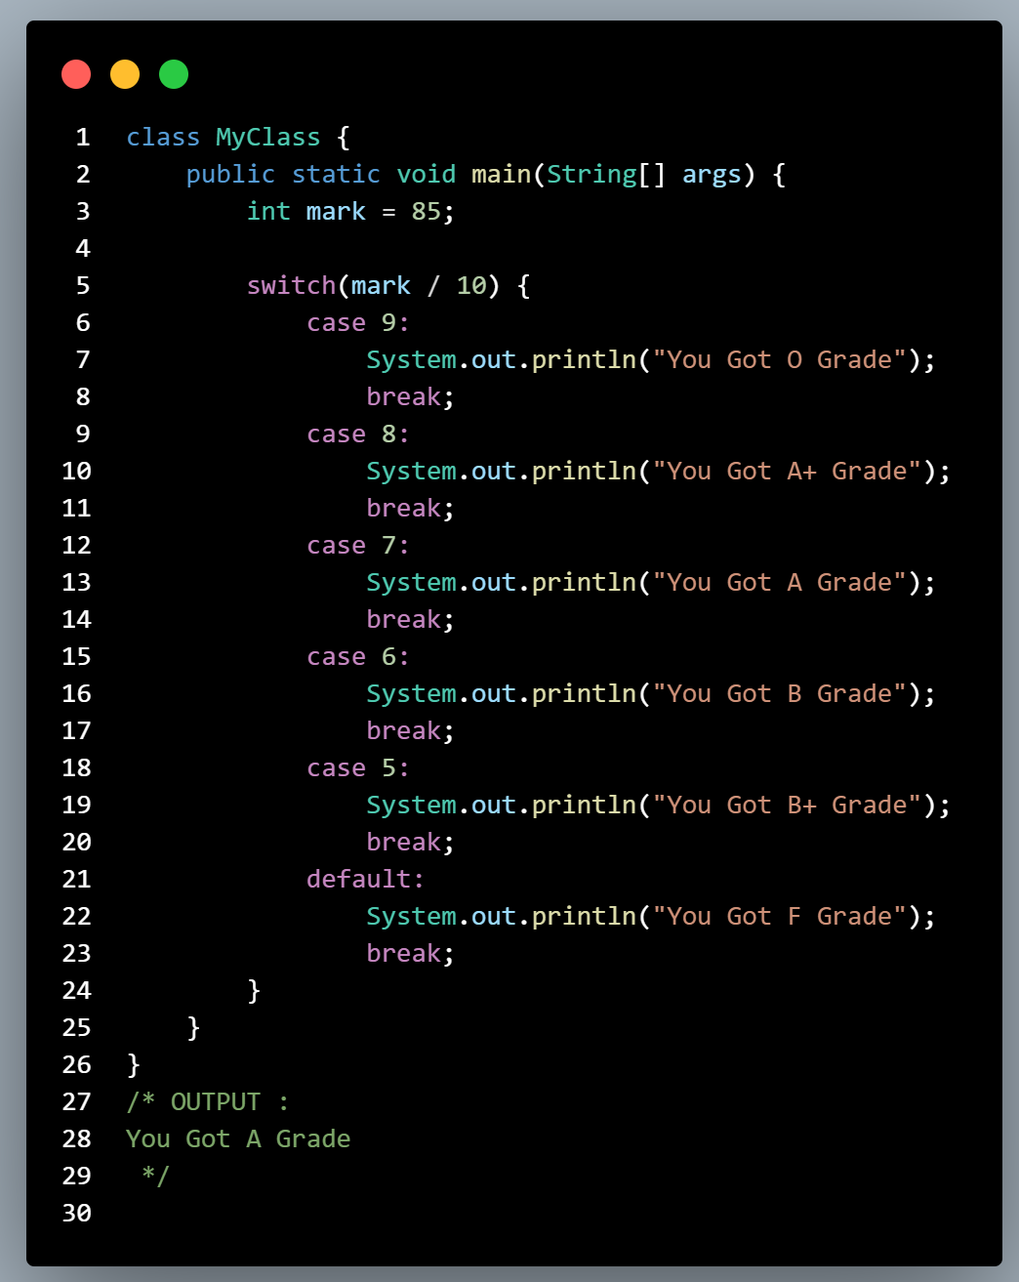
Hiveed.java
Switch case Syntax :
switch(Values/Variables){
case 1:{
//instruction
break;
}
case 2:{
//instruction
break ;
}
default{
//instruction
}
}
JAVA Programming

